Slide 1


“Ethical and Regulatory Issues in Neurotechnology”
Arleen Salles
Uppsala University, Sweden
October 27th, 2022
ISRC-CN³ Autumn School

Slide 2
Structure
Overview
Neuroethics
Guidelines and Recommendations
To do list?

Slide 3
1- What is it about neuroscience and neurotech?
Increases our understanding of the brain, what humans are, and how they behave
Sheds scientific light on a number of important topics
Nature of moral thought
Free will
Human and personal identity
Moral responsibility
Enables development and use of novel neurotechnologies, expected to drive significant changes to diverse areas from healthcare to gaming
Assessment
Neuroimaging
Interventional
Different forms of invasive and non invasive neurostimulation
Neuropharmacology for non-therapeutic uses
Notes:
It is good to know!!! Intrinsic and instrumental value of the knowledge. GOOD OF SOCIETY. HELPING PEOPLE.
BUT THERE ARE potential and actual implications

Slide 4
Neurotechnologies
Devices that interface with the brain that can sense or “read” information about or produced by the brain’s function, and/or offer input or “write” information into the brain to modulate function

Slide 5
Neurotech for what?
Medical Uses:
diagnose and monitor the brain and nervous system
Advance knowledge regarding how brain disorders are caused by abnormalities in electrical, biochemical, biomechanical signaling
Non-Medical Uses:
Wellness
relaxation, mindfulness, attention enhancement
Work:
Optimizing, facilitating, monitoring human behaviours in order to replece, improve, enhance tasks and performance
Law:
For assessing and monitoring behavioursa, application to interrogation, behavioural information
Entertainment and gaming
To enhance and facilitate experiences (virtual reality headsets)
Control engagement in gaming platforms

Slide 6
Issues
Privacy
Risks of exploitation (data from neuro-devices sold for marketing purposes)
Bias and discrimination
Fairness
Potential transformation of the status quo
Challenge to philosophical convictions about the nature of humanness itself and the line between humans and machines
Potential threats to human agency and autonomy
Dual uses and misuses (by law enforcement)

Slide 7
2- How to address them?
Conversations about ethical and societal considerations and impacts
neuroethics
Notes:
As an ethical strategy for the ethical and responsible development og technological innovation, can be Instrumental to developing political, economic relationships on a global level, fostering discussions about global trends in neurotechnolgicl development and deploym,ent

Slide 8
What is neuroethics?
Addresses scientific, philosophical, ELSI questions raised by neuroscience and related technologies
Multi and interdisciplinary
A response to advances in neuroscience that can challenge ingrained notions and potentially impact our value systems at the individual and communal levels

Slide 9
Neuroethics
- Use of ethical theory and reasoning to address a wide range of issues related to neuroscience and its products
- focus on relevant neuroscientific findings inform practical and theoretical issues
- Analysis of concepts such as privacy, personal identity, humanness
- Critical examination of conceptual assumptions and scientific interpretations
Notes:
there is growing consensus that neuroethics is not limited to the now familiar discussions of responsible conduct of research, compliance mechanisms, and practical management of ethical issues. In addition to examining how empirical knowledge of the brain can increase the understanding of human beings and human behaviour, neuroethics has additional components and contributes to the discussion of how neuroscience knowledge is constructed and why it might have explanatory or normative relevance.
This entails identifying, interrogating, and challenging underlying assumptions and unspoken value commitments within neuroscience, as well as exploring value commitments associated with neuroethical issues within broader publics and diverse cultures.

Slide 11
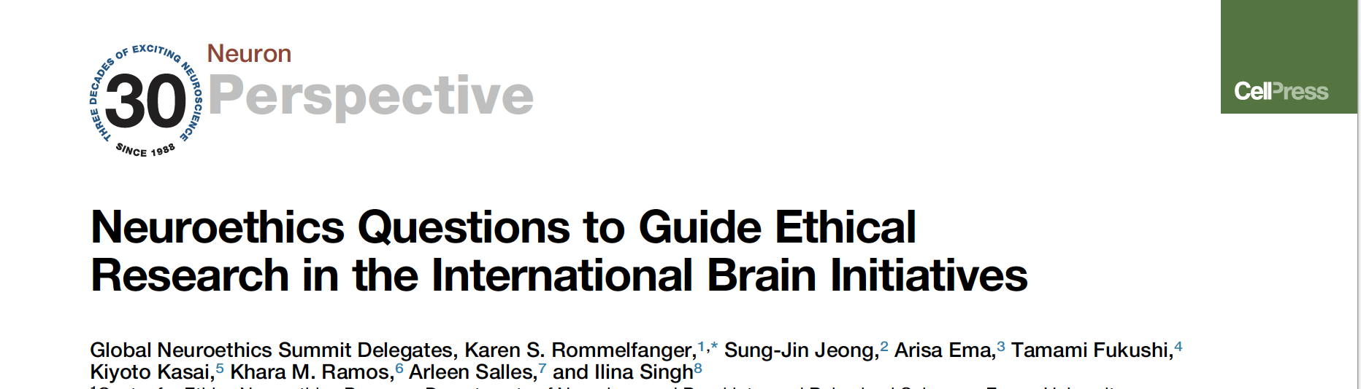
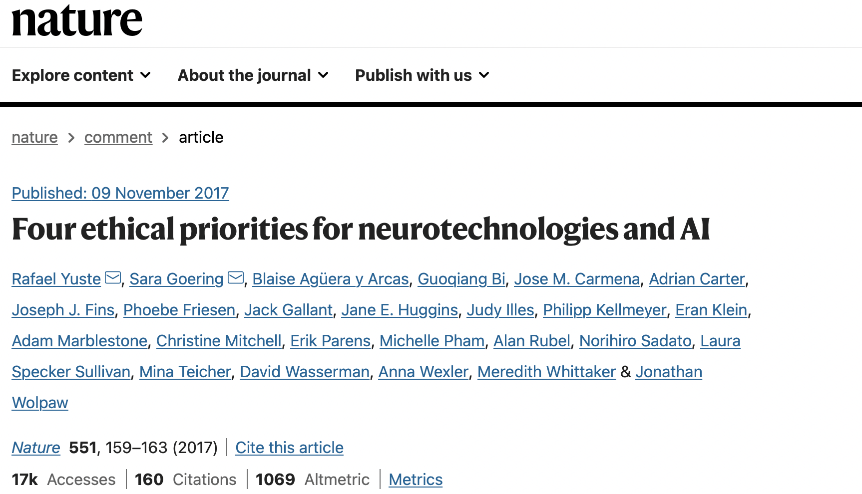
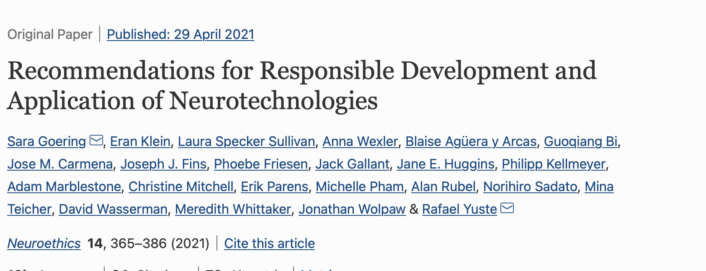

Slide 12

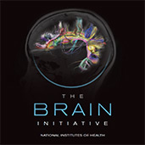
International Brain Initiatives and Neuroethics

Slide 13
Neuroethics Integration
Encourage integration of ethical and societal considerations into the different phases of the research, fromn design to applications
Call for interdisciplinarity from lab based neuroscientists and neurologists to philosophers and legal experts
Different from ethics consultation, it includes
Discussion of crucial ethical issues raised by developments in neuroscience
Proactive identification of ethical issues
Beyond compliance,
integration intended to shape the research, how it is understood and how it is discussed
Not just about impacts, but about ethical and responsible research

Slide 14
3- Beyond theory: guidelines and recommendations
Intended to help advance research within ethical boundaries
New ethical and regulatory frameworks?

Slide 15
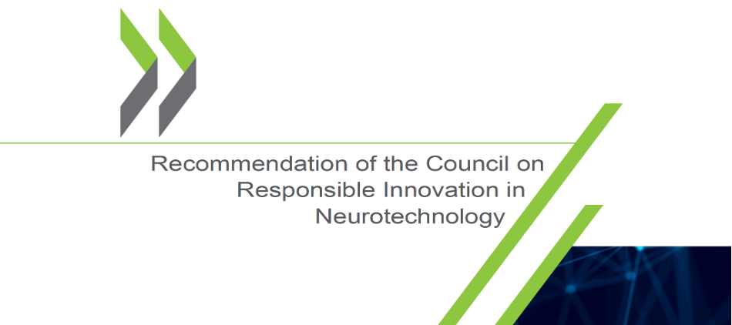
OECD Recommendations

Slide 16
OECD Recommendations
Approximately 40 countries have committed to implementing the priniples embodied in the recommendations:
1. Promoting responsible innovation
2. Prioritising safety assessment
3. Promoting inclusivity
4. Fostering scientific collaboration
5. Enabling societal deliberation
6. Enabling capacity of oversight and advisory bodies
7. Safeguarding personal brain data and other information
8. Promoting cultures of stewardship and trust across the public and private sector
9. Anticipating and monitoring potential unintended use and/or misuse.

Slide 17
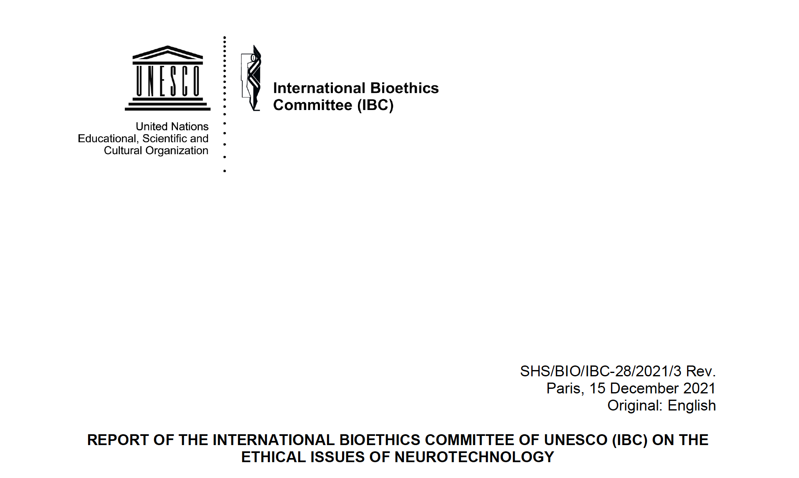
Cerebral/mental integrity and human dignity
Personal identity
Freedom of thought, cognitive liberty and free will
Mental privacy and brain data confidentiality
Distributive justice
Discrimination/bias
Misuse
Augmentation/enhancement
Interests of the child
Informed consent

Slide 18

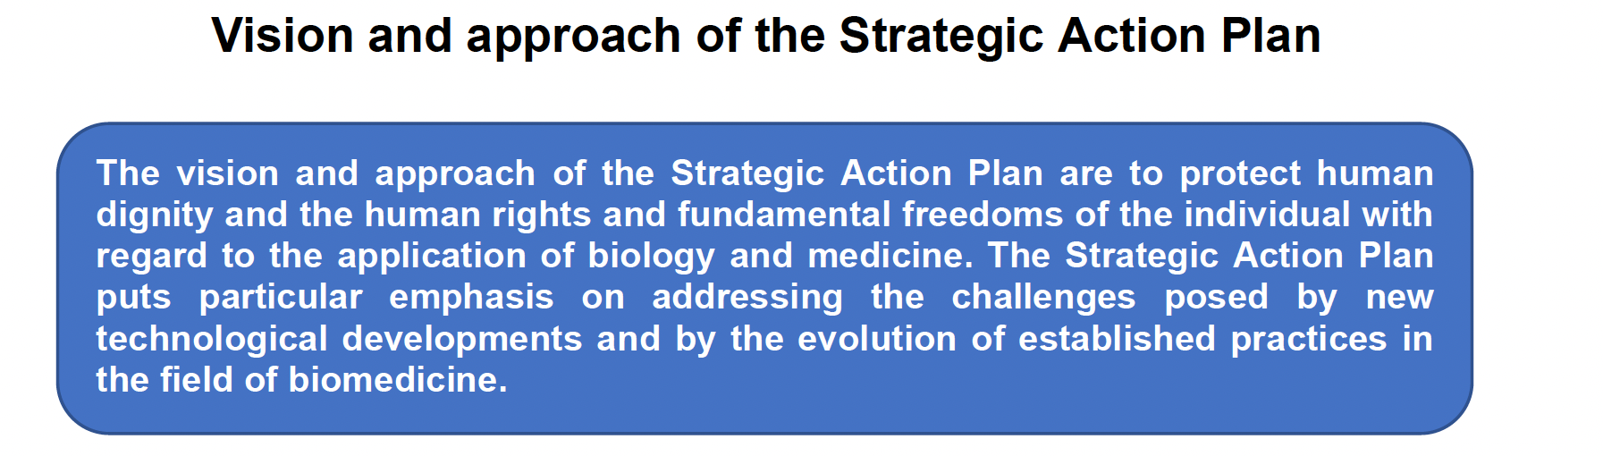
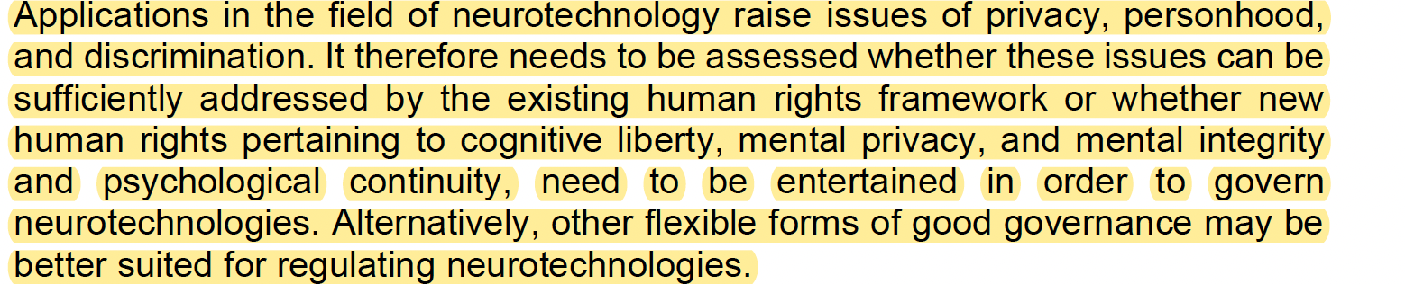
CoE

Slide 19
Similarities and Differences
Characteristics:
In common
Promotion of responsible design, development and deployment of neurotechnologies
Benefit to the public
Call for increased communication and engagement
Brain exceptionalism
Differences
Strategies
Targets
Underlying assumptions and frameworks
Responsible Research and Innovation
Principles of medical ethics
Assignation of responsibility
Topics:
Usual suspects with added complexity
Uniquely relevant for neurotechnologies
Some challenges
Specification
Implementation
Are they enough?

Slide 20
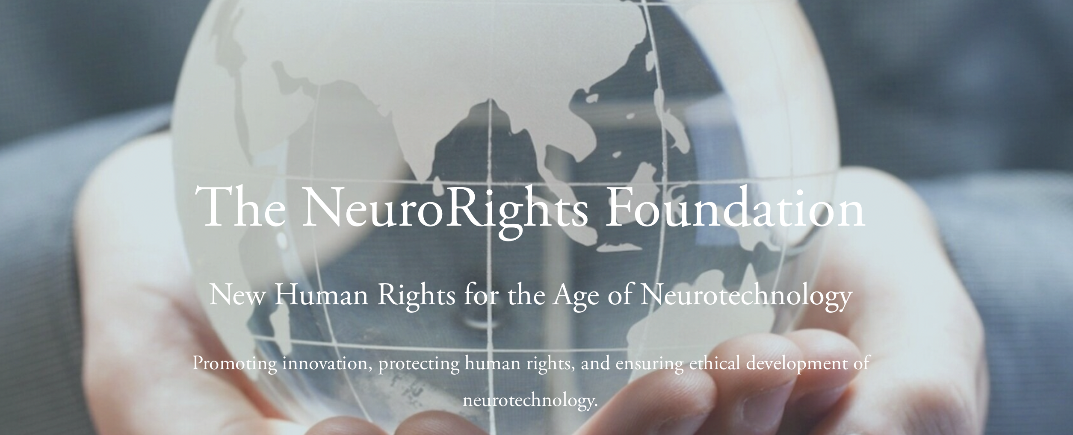
Gaps in existing laws, regulations and soft approaches?
Growing call for special brain rights
Notes:
Numerous civil society organizations are currently evaluating legal and ethical frameworks for neurotechnologies, notably the Neurorights Foundation, whose mission to develop “new human rights for the age of neurotechnology.

Slide 21
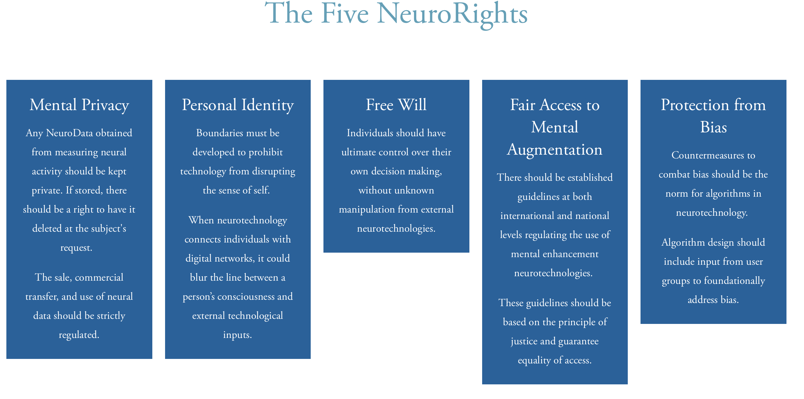

Slide 22
Neurorights
Advocates for neurorights generally agree that
(1) neurodata is a special category of information inextricably connected to people’s identity and agency, which serve as the basis for all other freedoms, and
(2) individuals have a right to the integrity and privacy of their neurological processes, including related data.
Questions
To advance or protect these interests, are neurorights necessary?
Who should define neurorights, and which legal structures are appropriate to embody and advance them?
Some Challenges
Conceptual
engagement

Slide 23
Pending Issues
Recognition that deep reaching scientific and technological changes will take place,
how they will be expressed
how they should be addressed
From regulatory perspective:
Are uniform regulations viable in all situations?
Are there ethical standards that shgould be universally informed?
Will the new tehcnological trends promote common values or more separation?

Slide 24
In the meantime, what can we do?
Build a culture of ethics in science
Provide education for early career scientists and ethicist alike
Embed ethics experts in scientific research
Give Institutional attention to ethics and society, incentives
Engage with diverse publics
Notes:
Task: proactively diesign engagement strategies.
challenges

Slide 25
Thank You!
Twitter @arleensalles

